Slide 1
Employee Data Analysis using Excel
STUDENT NAME :POONGAVANAM S
REGISTER NO :312220768,
51524D1CFA558DFB62B41BCE5EA411E7
DEPARTMENT :B.Com (General)
COLLEGE :Arulmigu Kapaleeswarar Arts And Science College

Slide 2
PROJECT TITLE
EMPLOYEE PERFORMANCE ANALYSIS USING EXCEL

Slide 3
AGENDA
Problem Statement
Project Overview
End Users
Our Solution and Proposition
Dataset Description
Modelling Approach
Results and Discussion
Conclusion

Slide 4

PROBLEM STATEMENT
Employee performance is defined as how well a person executes their job duties and responsibilities. The companies assess their employees performance on an annual or quarterly basis to define certain areas that they need improvement and to encourage further success in the expected areas. Decrease productivity, difficulity prioritizing task, commiting errors in projects or missing deadlines.

Slide 5

PROJECT OVERVIEW
The project involves analyzing employee data using Excel which helps in gaining the knowledge regarding organizational data, performance statistical analysis by creating visualizations to understand the employee performances. Be clear on what you want to achieve with the project and project delivery requirement.

Slide 6

WHO ARE THE END USERS?
The end users in employee performance analysis include:
1. Human Resource management professionals.
2. Data Analysts.
3. Team Leaders.
4. Superiors
5.Socializers
6. Achievers
7. Employeers
8. Managers

Slide 7

OUR SOLUTION AND ITS VALUE PROPOSITION
*Filtering- purpose to fill the missing values.
*Conditional formatting- blank values.
*Usage- Pivot table and data chart.

Slide 8
Dataset Description
Employee data set- Kaggle
There are 26 features
The important seven features are,
Employment ID
First name
Last name
Gender
Employee status
Employee type
Employee classification

Slide 9

THE "WOW" IN OUR SOLUTION
Performance Level– These include the categories such as Levels in very high, high, medium, low, etc...
Using Pivot table and charts for analysing the employees performance.
3/21/2024 Annual Review
9

Slide 10
MODELLING
The modelling in this employee performance analysis project includes the following:
*Data collection
*Data cleaning
*Techniques
*Results
*Pivot table
*Chart graphs
10

Slide 11
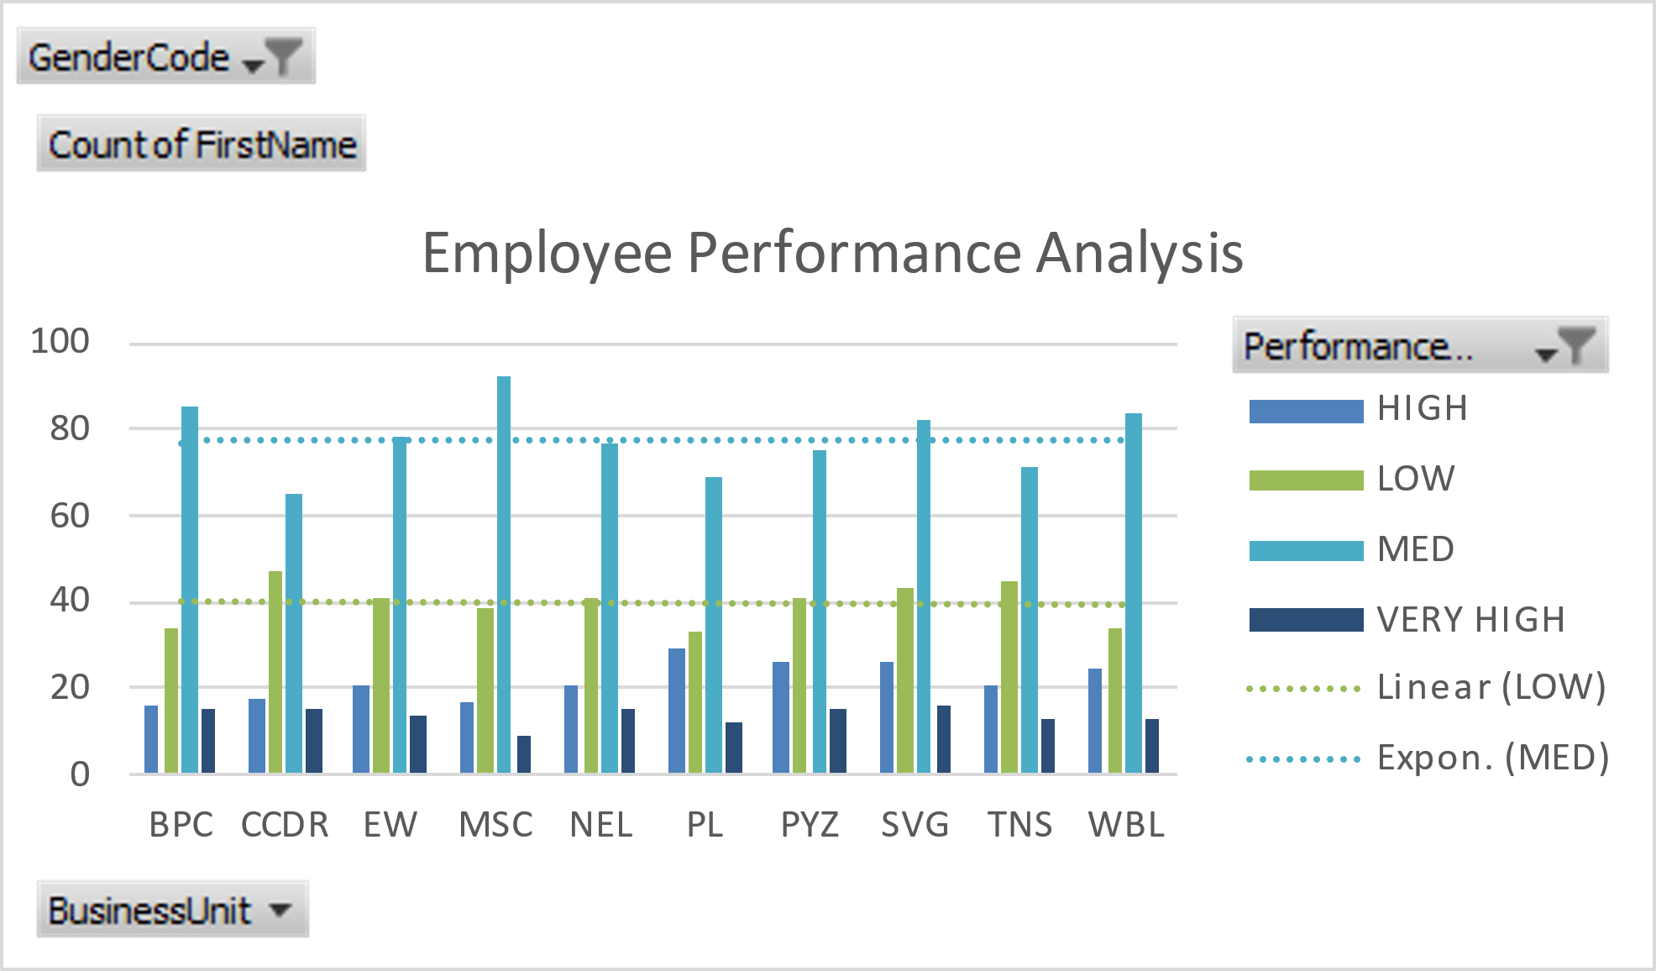
RESULTS
11

Slide 12
CONCLUSION
To conclude, the employee data analysis reveals the key insights in workforce performance and areas needed for improvement. By analyzing the data such as productivity, turnover rates and engagement levels, these organizations can identify the strengths and weakness in their workforce environment. Companies use employee performance evaluations as a tool document and employee’s performance over time.

